Slide 1
Real-time stream processing with Stream Analytics

Slide 2
Agenda
Recap of streaming data concepts
Data ingest options in Azure
Stream processing using Stream Analytics

Slide 3
Recap of streaming data concepts
1
Notes:
TALKING POINTS
Let’s go over data integration with Azure Data Factory or Azure Synapse Pipelines.
PRESENTER NOTES AND GUIDANCE
N/A.

Slide 4
Velocity: the 3 latencies
1
Batch Queries or programs that take tens of minutes, hours, or days to complete. Could include initial data munging, complete ETL pipeline, preparation for downstream analytics.
2
Interactive query Querying batch data at “human” interactive speeds, which with the current generation of technologies means results are ready in time frames measured in seconds to minutes.
3
Real-time / near real-time Processing of a typically infinite stream of input data (stream), whose time until results ready is short—measured in milliseconds or seconds in the longest of cases.
You will typically use these three velocities together. Batch is always at the periphery of real-time stream ingestion, because you oftentimes want to do a deeper analysis of the ingested data.
Notes:
Batch queries or programs that take tens of minutes, hours, or even days to complete. Initial data munging efforts to a more complete ETL pipeline, to preparing data for ultimate consumption over very large data sets or where the computation takes significant time. In other words, batch processing is a step in your lambda architecture processing pipeline—one that either leads to further interactive exploration (downstream analytics), provides the modeling-ready data for machine learning, or lands the data in a data store optimized for analytics and visualization.
Interactive query capabilities by pruning large data sets during query processing to achieve faster query execution. Indexes, partitioning, predicate pushdown (where clauses) toward the storage layer, not after you received all the data

Slide 5
Real-time sources
Many sources arriving at many velocities
IoT/sensors
Financial tx
Clickstream
Factories
Space
Medical

Slide 6
Streaming concepts
Stream processing is where you continuously incorporate new data and compute results
Streaming data comes in faster than it can be consumed
Stream of data is treated as a table to which data is continuously appended
Data is typically not ordered in any way

Slide 7
Data ingest options in Azure
2
Notes:
Talking Points:
Let’s look at how you can do code-free transformations at scale using Azure Data Factory or Synapse Pipelines.

Slide 8


Event Hubs – cloud-scale telemetry ingestion
Big data pipeline Azure Event Hubs is a big data pipeline (can receive/process millions events/second)
Works with streaming data It facilitates the capture, retention, and replay of telemetry and event stream data (HTTPS, AMQP, AMQP over websockets, Kafka)
High throughput with optional ordering At least once delivery of events with low latency and high throughput. Event ordering ensured per partition
Ingest multiple sources simultaneously The data can come from many concurrent sources and up to 20 consumer groups can allow applications to read entire event hub independently at their own pace
Notes:
Stream millions of events per second in real-time
Send telemetry data automatically to storage, allowing you to process real-time and batch on the same stream
Read data from multiple applications and services using publish-subscribe semantics, including custom apps, Azure Functions, and Apache Spark
Up to 20 consumer groups can be used to allow consuming applications to read the entire event hub independently at their own pace
Partitions enable horizontal scale for event processing
Send events to the same partition to ensure order

Slide 9

IoT Hub – connect/monitor/manage billions IoT of assets
Big data pipeline IoT Hub uses Event Hubs for its telemetry path, so is also a big data pipeline (can receive/process millions events/second)
Per-device identity Secure your IoT solution from potential attacks with unique device-level identity; authorize and revoke device connections
Cloud-to-device messaging Send messages to devices from the cloud as direct messages for immediate confirmation, or device twin properties for long-running commands
Automate IoT device provisioning Speed up your IoT deployment by registering and provisioning devices with zero touch in a secure & reliable way
HTTPS, AMQP, AMQP over websockets,
MQTT, MQTT over websockets

Slide 10

Cosmos DB – ingest and serve data at global scale
Highly scalable across global regions Cosmos DB elastically scales globally for both storage (GB to PB) and throughput (100 to 100M requests/second)
Flexible document TTL Configure TTL (time-to-live) at the collection or document level to automatically delete messages after specified time
Change feed can trigger downstream processing Every time a document is added, updated, or deleted, the change feed can trigger services such as Azure Databricks or Azure functions to evaluate and process that data

Slide 11

Event Grid – react to and capture 1st party and custom events
Enables event-driven, reactive programming Uses a publish-subscribe model where publishers have no expectation of which events are handled
High scalability Serverless, in that you pay for what you use. Event Grid can scale to 10,000,000 events per second per region
Integrate with IoT Hub IoT Hub publishes device events (created, deleted, disconnected), but can now publish telemetry events (in preview). Event Grid offers 500 endpoints vs. 10 custom IoT Hub endpoints Do NOT use if message ordering is important

Slide 12














Central management of all events
Event publishers
Event handlers
Blob Storage
Serverless Code
Resource Groups
Functions
Azure Subscriptions
Event Grid
Serverless Workflow and Integration
Event Hubs
CloudEvents Format
Logic Apps
Azure Media Service
Buffering and
Competing Consumers
IoT Hub
Service Bus
Event Hubs
Storage
Queues
Custom Events
Other Services and Applications
CloudEvents Sources
Hybrid Connections
(WebSockets)
WebHooks (anything)
Azure Automation
Notes:
The Azure Serverless platform can now handle CloudEvents as well as emit all Azure platform events in CloudEvents format, natively. We also now support BYO JSON formats with input bindings in addition to continued support for the native Azure format. In facet any permutation of the three is supported, so you can ingest your proprietary event format into Event Grid and react to it with an Azure function, or just as easily fire a Blog Storage event off to nearly every major functions platform available today – and because we convert it on the wire to CloudEvents format, you have a native, uniform experience wherever you are.

Slide 13
Stream processing using Stream Analytics
3

Slide 14
Using a lambda architecture
Speed Layer
Input Data
Analytics Client
Real-Time Views
“Hot” Path
Batch Layer
Serving Layer
Master Data
Batch Views
“Cold” Path

Slide 15
Event processing
The process of consuming data streams, analyzing them, and deriving actionable insights out of them is called Event Processing and has three distinct components:
Event producer
Examples include sensors or processes that generate data continuously such as a heart rate monitor or a highway toll lane sensor
Event processor
An engine to consume event data streams and deriving insights from them. Depending on the problem space, event processors either process one incoming event at a time (such as a heart rate monitor) or process multiple events at a time (such as a highway toll lane sensor)
Event consumer
An application which consumes the data and takes specific action based on the insights. Examples of event consumers include alert generation, dashboards, or even sending data to another event processing engine
Notes:
There are several services available for real-time analytics and streaming processing on Azure. Regardless of the technology used, they all work with three distinct components:
- Event Producers
- Event Processors
Event Consumers
The two main real-time analytics and streaming processing technologies on Azure are Stream Analytics and Kafka.
https://docs.microsoft.com/azure/stream-analytics/streaming-technologies

Slide 16

Process streams using Stream Analytics
Stream Analytics
Stream Analytics on IoT Edge
High volume event-processing engine using SQL-like language
Output to multiple data sinks such as Service Bus, Power BI, Cosmos DB, Event Hubs, SQL Database
SQL, C#/JavaScript UDFs
Uses the same query language on both cloud and edge
Deploys to Docker container on IoT edge device
Good for filtering & aggregating data locally before sending to the cloud

Slide 17
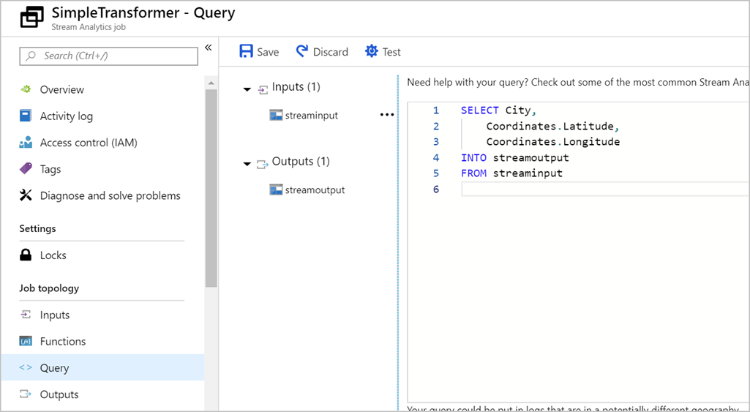
Transform data by using Azure Stream Analytics
Declarative SQL like language
Contains testing capabilities
Performs aggregations over windows of time
Notes:
Azure Stream Analytics enables you to develop massively parallel Complex Event Processing (CEP) pipelines with simplicity. In these pipelines you are enabled to author powerful, real-time analytics solutions using very simple, declarative SQL like language with embedded support for temporal logic. You can, for example, perform aggregations on the telemetry data over certain windows of time. With the test feature within Azure Stream Analytics, you can easily test the query if the output is what you expected.
In Azure Stream Analytics, we call this pipeline a job, which is a unit of execution.
A Stream Analytics job pipeline consists of three parts:
- An input that provides the source of the data stream.
- A transformation query that acts on the input. For example, a transformation query could aggregate the data over windows of time
- An output that identifies the destination of the transformed data.
Transform data by using Azure Stream Analytics - Learn | Microsoft Docs

Slide 18
Using Windowing functions with Azure Stream Analytics
Performing operations on the data contained in temporal windows is a common pattern. Stream Analytics has native support for windowing function including
Tumbling
Hopping
Sliding
Session
Tumbling window functions are used to segment a data stream into distinct time segments and perform a function against them.
For example, tell me the count of tweets per time zone every 10 seconds
Hopping window functions hop forward in time by a fixed period.
For example, every 5 seconds, give me the count of tweets for the last 10 seconds
Sliding windows, output events only for points in time when the content of the window actually changes.
For example, give a count of all tweets which are tweeted more than 10 times on a given topic
Session window functions group events that arrive at similar times, filtering out periods of time where there is no data.
For example, give the count of tweets that occur within 5 minutes of each other
Notes:
In time-streaming scenarios, performing operations on the data contained in temporal windows is a common pattern. Stream Analytics has native support for windowing functions, enabling developers to author complex stream processing jobs with minimal effort.
There are five kinds of temporal windows to choose from: Tumbling, Hopping, Sliding, Session, and Snapshot windows. You use the window functions in the GROUP BY clause of the query syntax in your Stream Analytics jobs. You can also aggregate events over multiple windows using the Windows() function.
All the windowing operations output results at the end of the window. Note that when you start a stream analytics job, you can specify the Job output start time and the system will automatically fetch previous events in the incoming streams to output the first window at the specified time; for example when you start with the Now option, it will start to emit data immediately. The output of the window will be single event based on the aggregate function used. The output event will have the time stamp of the end of the window and all window functions are defined with a fixed length.
https://docs.microsoft.com/learn/modules/ingest-data-streams-with-azure-stream-analytics/6-describe-windowing-functions
https://docs.microsoft.com/azure/stream-analytics/stream-analytics-window-functions

Slide 19
Windowing functions examples with Azure Stream Analytics
Tumbling
Hopping
Sliding
Session
SELECT
Timezone,
Count(*) as Count
FROM
TwitterStream
TIMESTAMP BY
CreatedAt
GROUP BY
Timezone
TUMBLINGWINDOW (second, 10)
SELECT
Timezone,
Count(*) as TotalTweet
FROM
TwitterStream
TIMESTAMP BY
CreatedAt
GROUP BY
Topic
HOPPINGWINDOW (second, 10, 5)
SELECT
Topic,
Count(*)
FROM
TwitterStream
TIMESTAMP BY
CreatedAt
GROUP BY
Topic
SLIDINGWINDOW (second, 10)
HAVING COUNT(*) > 10
SELECT
Timezone,
Count(*)
FROM
TwitterStream
TIMESTAMP BY
CreatedAt
GROUP BY
Topic
SESSIONWINDOW (minute 5, 10)
Notes:
This slide is a following on from the previous slide that shows the code behind the examples
https://docs.microsoft.com/learn/modules/ingest-data-streams-with-azure-stream-analytics/7-exercise-create-query-using-tumbling-windows
https://docs.microsoft.com/azure/stream-analytics/stream-analytics-window-functions

Slide 20
LAB 10: Real-time stream processing with Stream Analytics
60 minutes

Slide 21


Conference workshop presentations
Solliance Training
https://aka.solliance.net/azure-de-workshop
https://training.solliance.net

